Slide 1




Environmental genomics
for broadscale studies on
aquatic microbial diversity and evolution
Krzysztof T. Jurdzinski
under supervision of
Anders F. Andersson
Department of Gene Technology, KTH

Slide 2
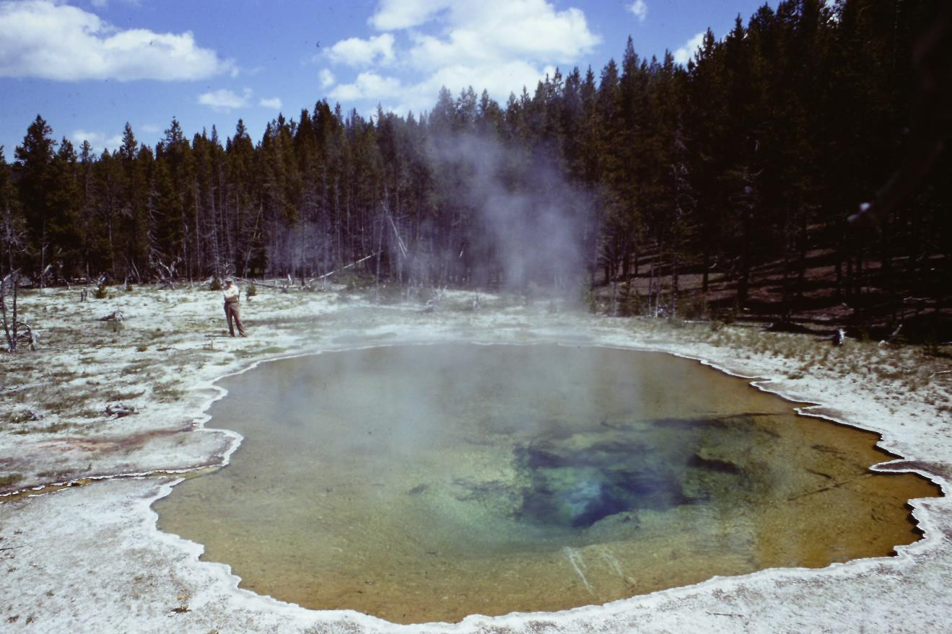
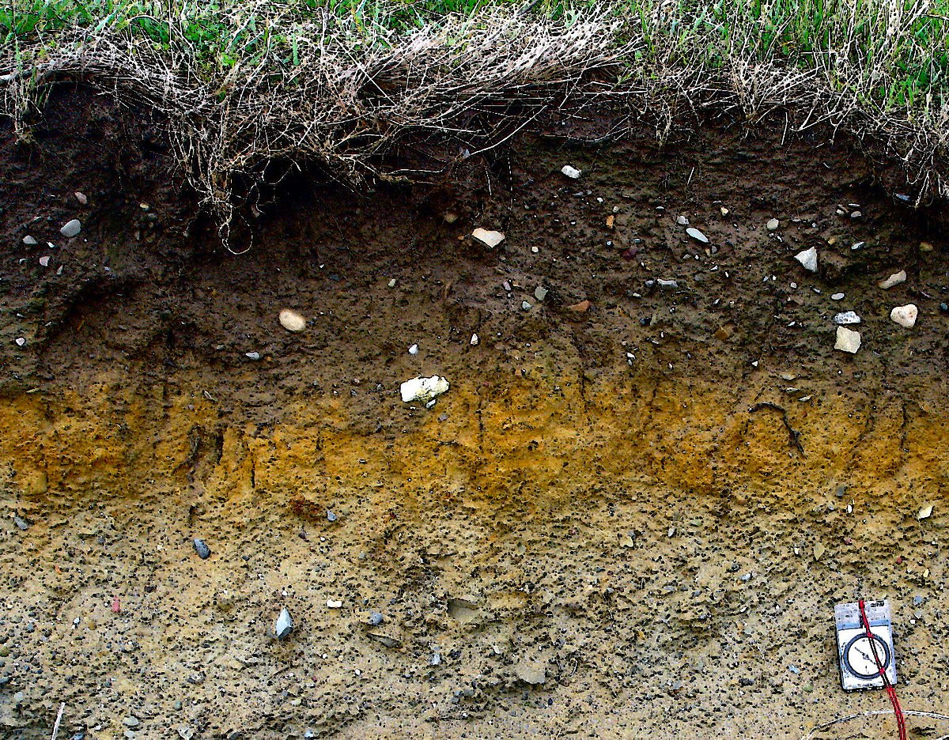
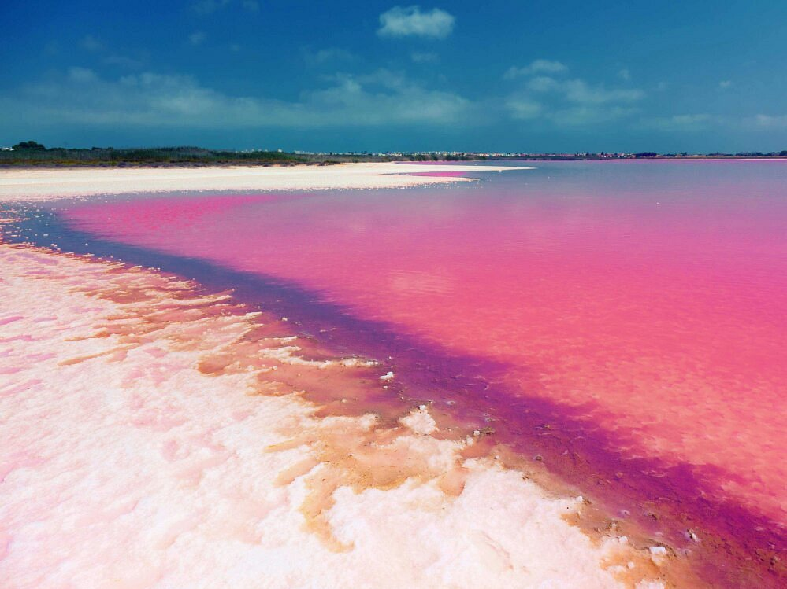
Have you ever used?
PCR?
CRISPR?
Antibiotics?
Thomas Brock
René Dubos et al.
Source: HolgerK, Wikicommons
Francisco Mojica
Source: Luis S. at Tripadvisor

Slide 3
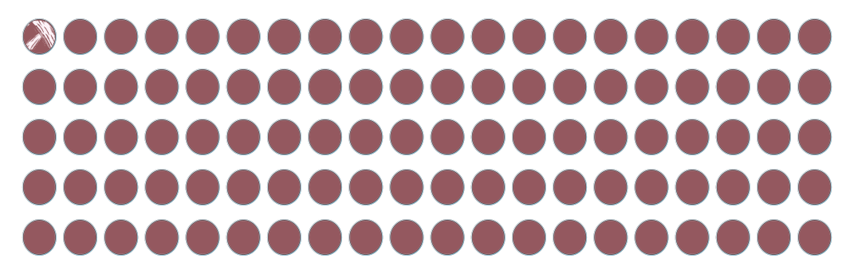
All of that was based on cultivation…
Only around 1% of bacterial diversity brought into the lab

Slide 4
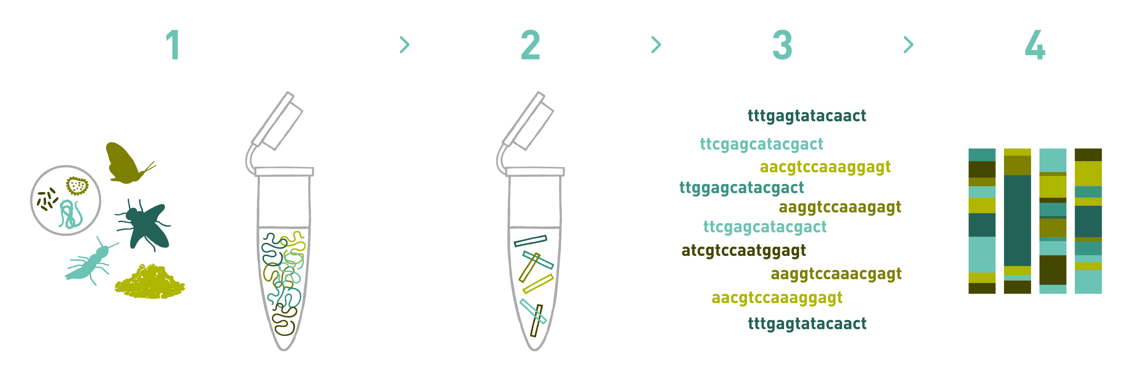
Metagenomics
Bioinformatic analysis
Gene/genome (de novo) assembly
Metagenome assembled genomes (MAGs)
Relative abundance
Mapping
Shotgun metagenomics
Fragment and sequence all!
Metabarcoding
Amplify marker genes (16S, 18S, ITS, COI…)
Environmental DNA
www.allgenetics.eu

Slide 5
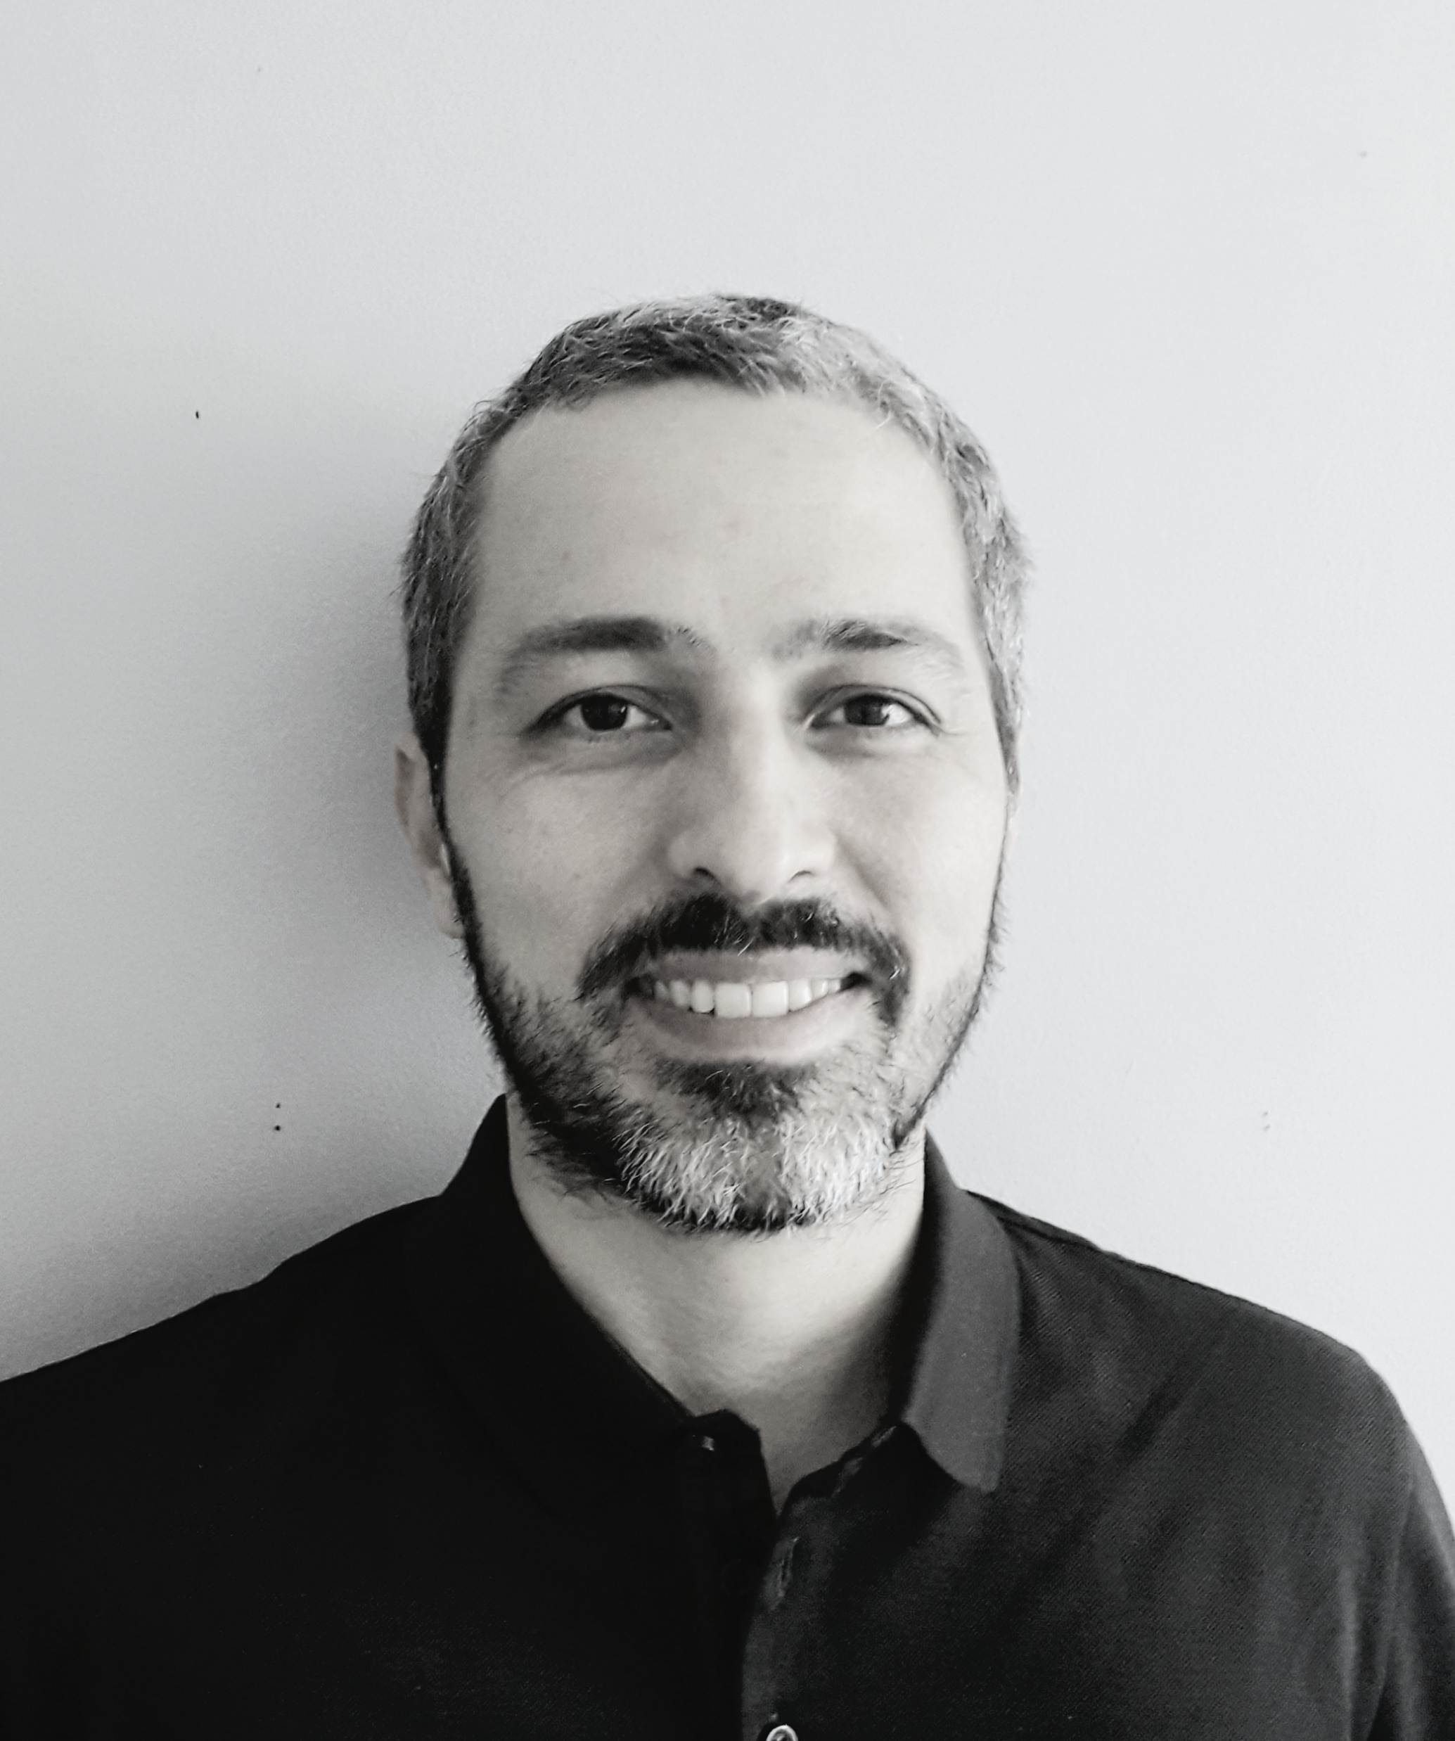

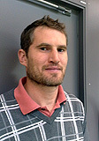

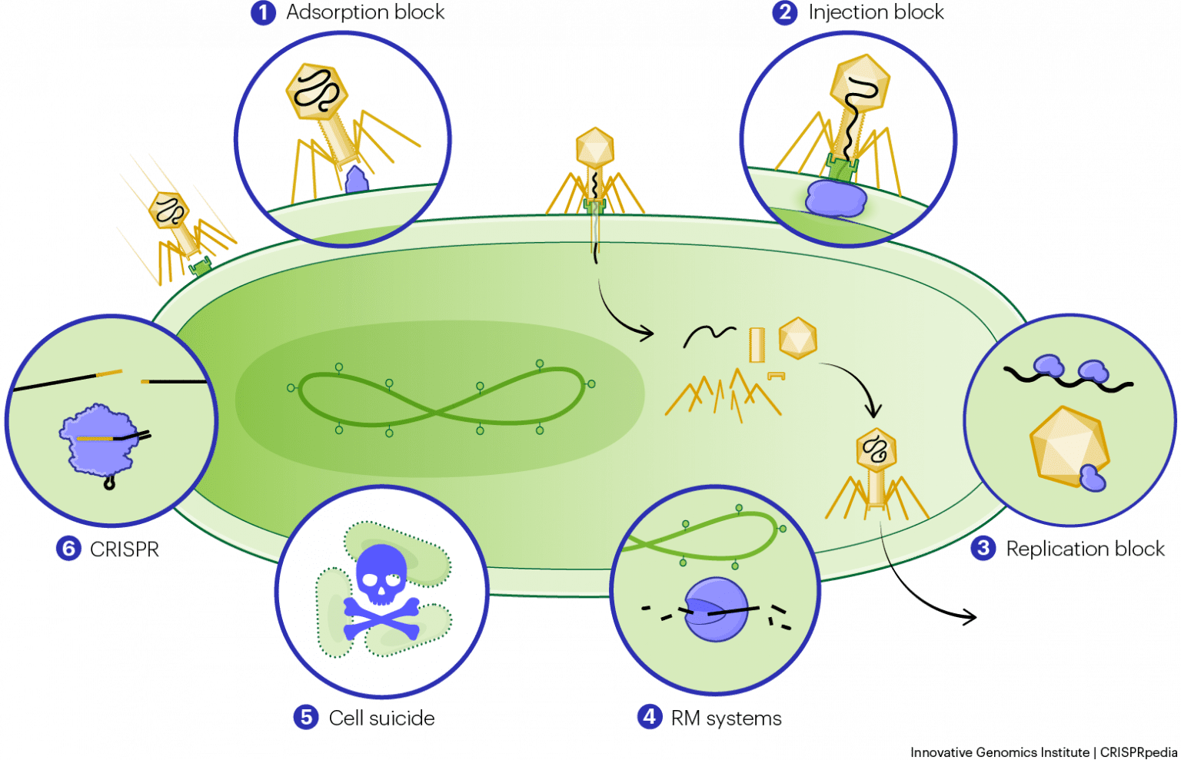
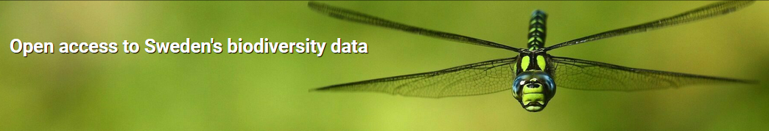
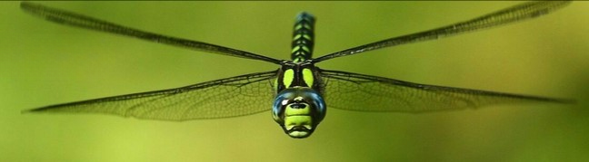
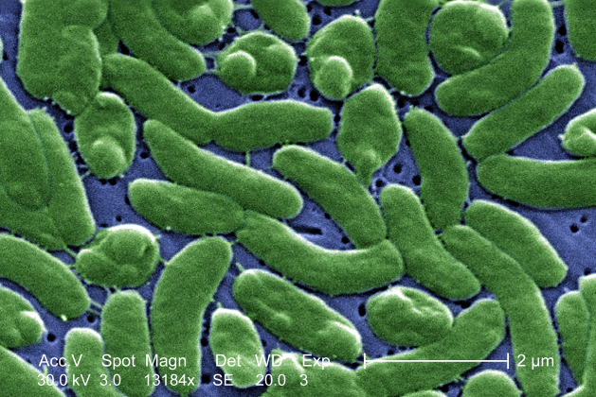
Major ENVGEN projects I am not involved in
BaltVib
Microbe-phage interactions
in the Baltic Sea
Fernando
Emma
Anders
Bacteria-virus population dynamics linked by CRISPRs
Pathogenic Vibrio bacteria in the current and future Baltic Sea waters: mitigating the problem
Swedish Biodiversity Data Infrasctrutre
Source: CDC Public Health Image Library
Source:innovativegenomics.org | CRISPRpedia

Slide 6

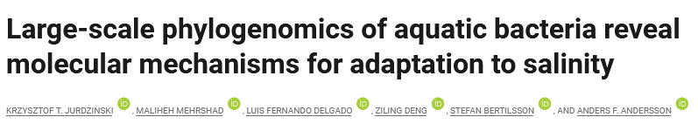
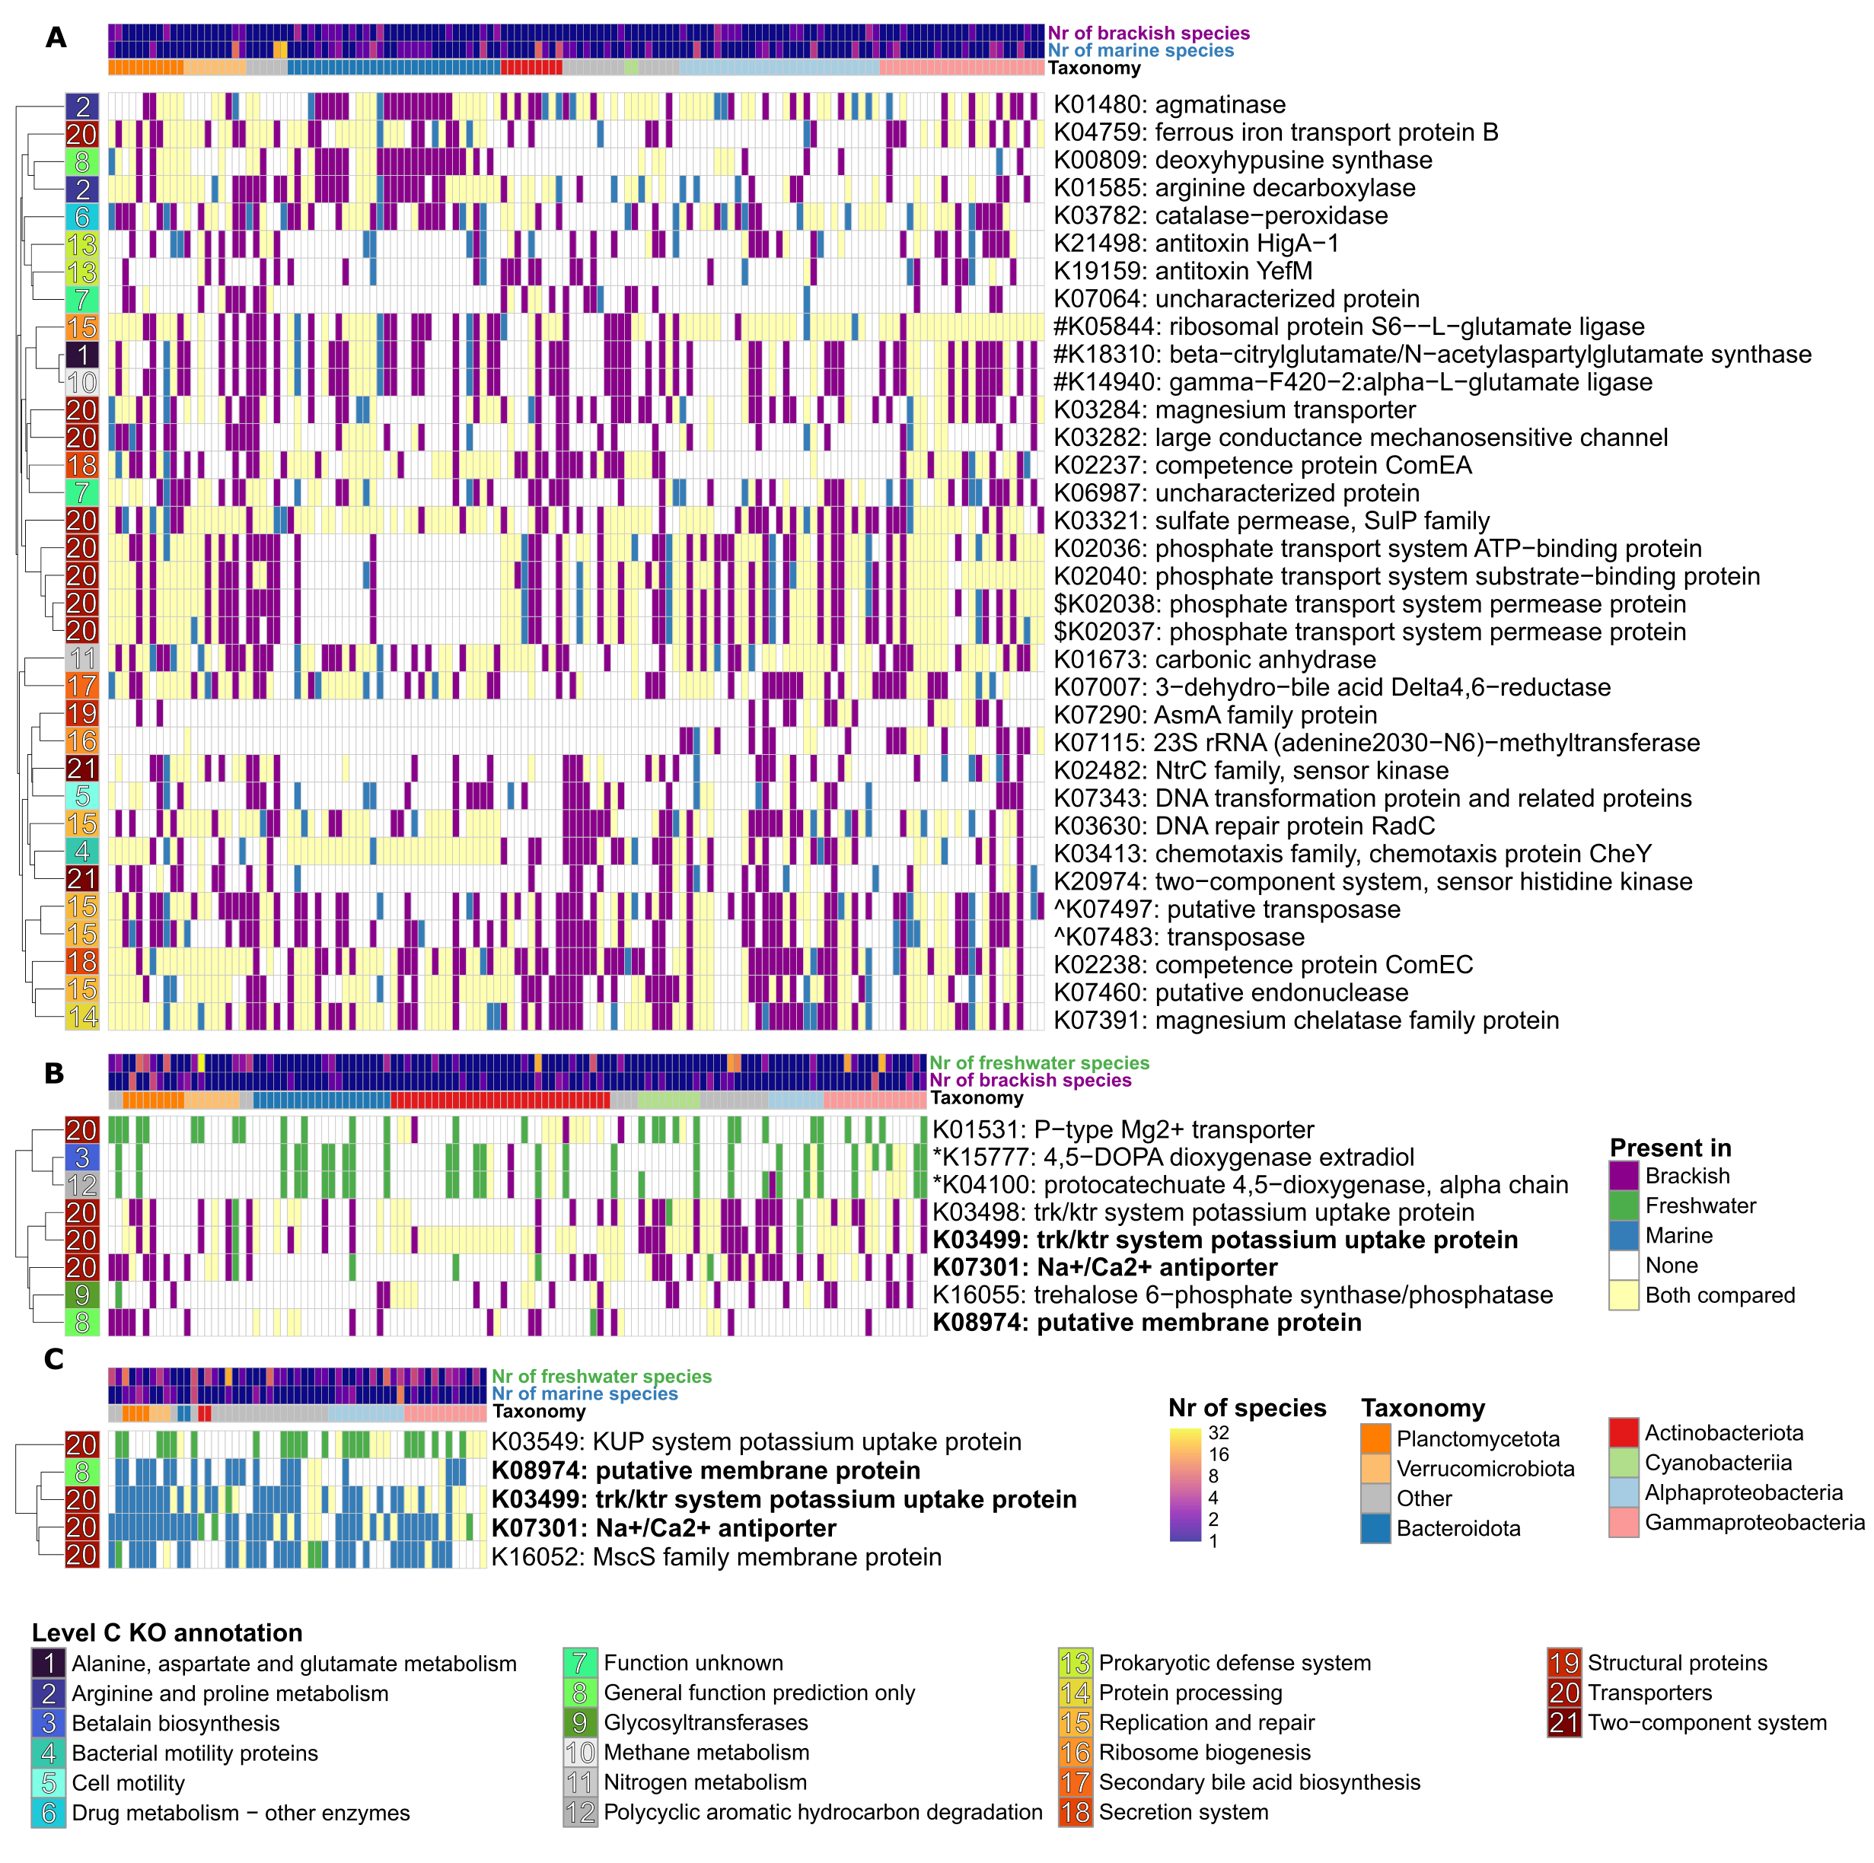
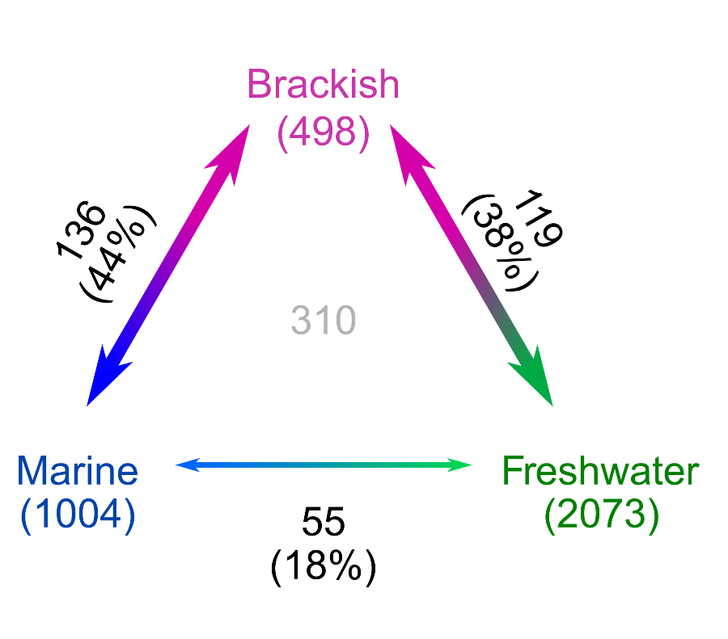
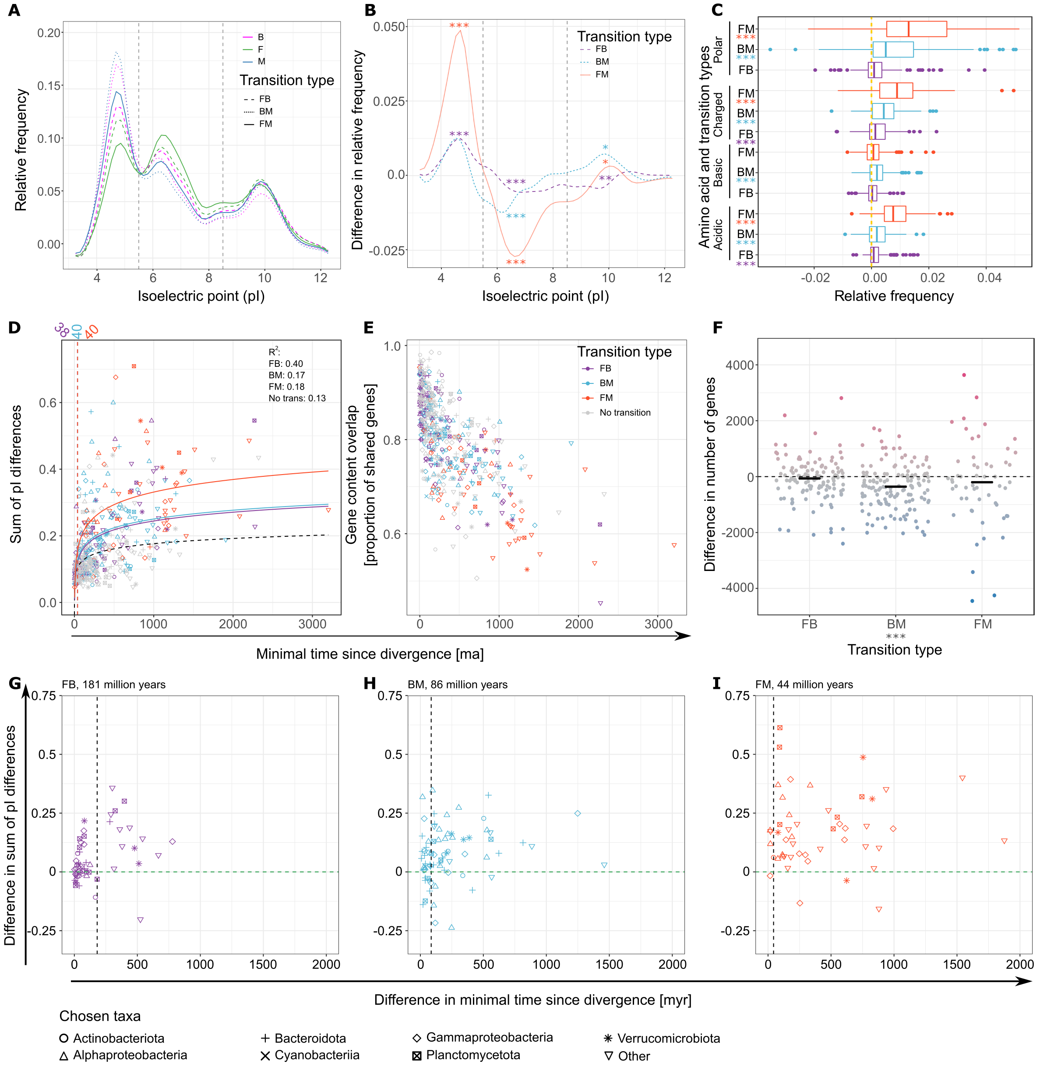
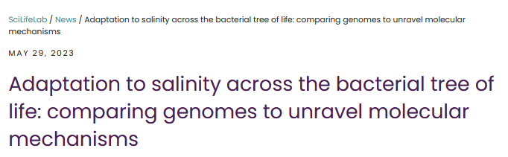
Salinity and bacterial evolution (Project 1)
Proteome-scale changes in
protein properties and
amino acid composition
Gains and losses of specific
Gene functions
Three aquatic biomes and
rare evolutionary transitions between them
Brackish microbiome - Hugerth et al. 2015
And it takes
millions of year!
Inspired by Cabello-Yeves and Rodriguez-Valera (2019)

Slide 7
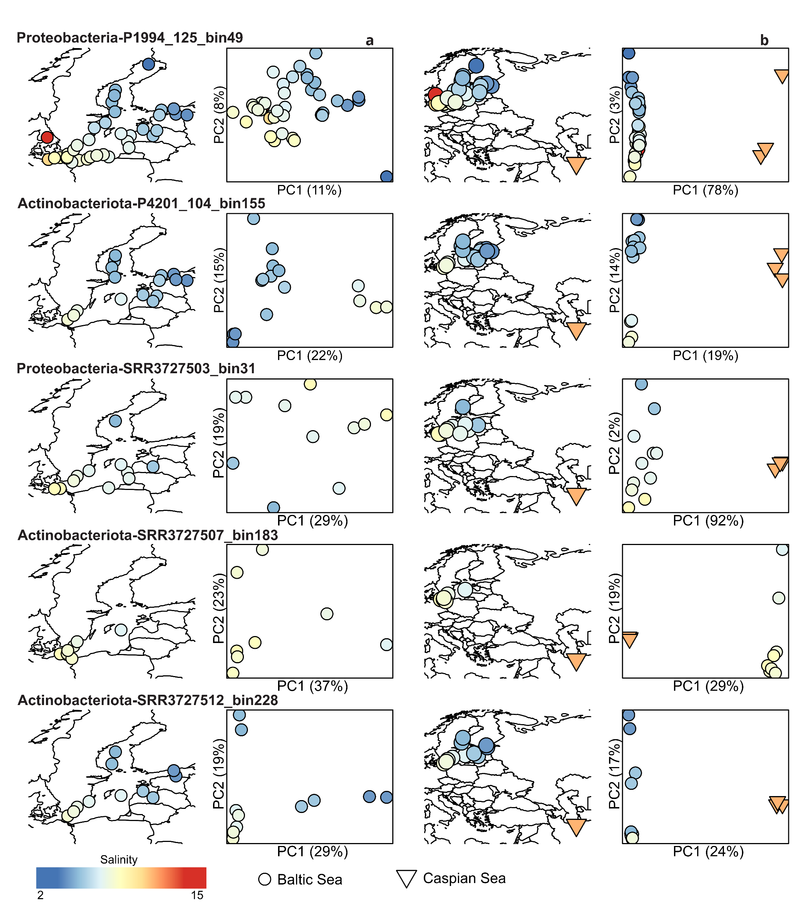
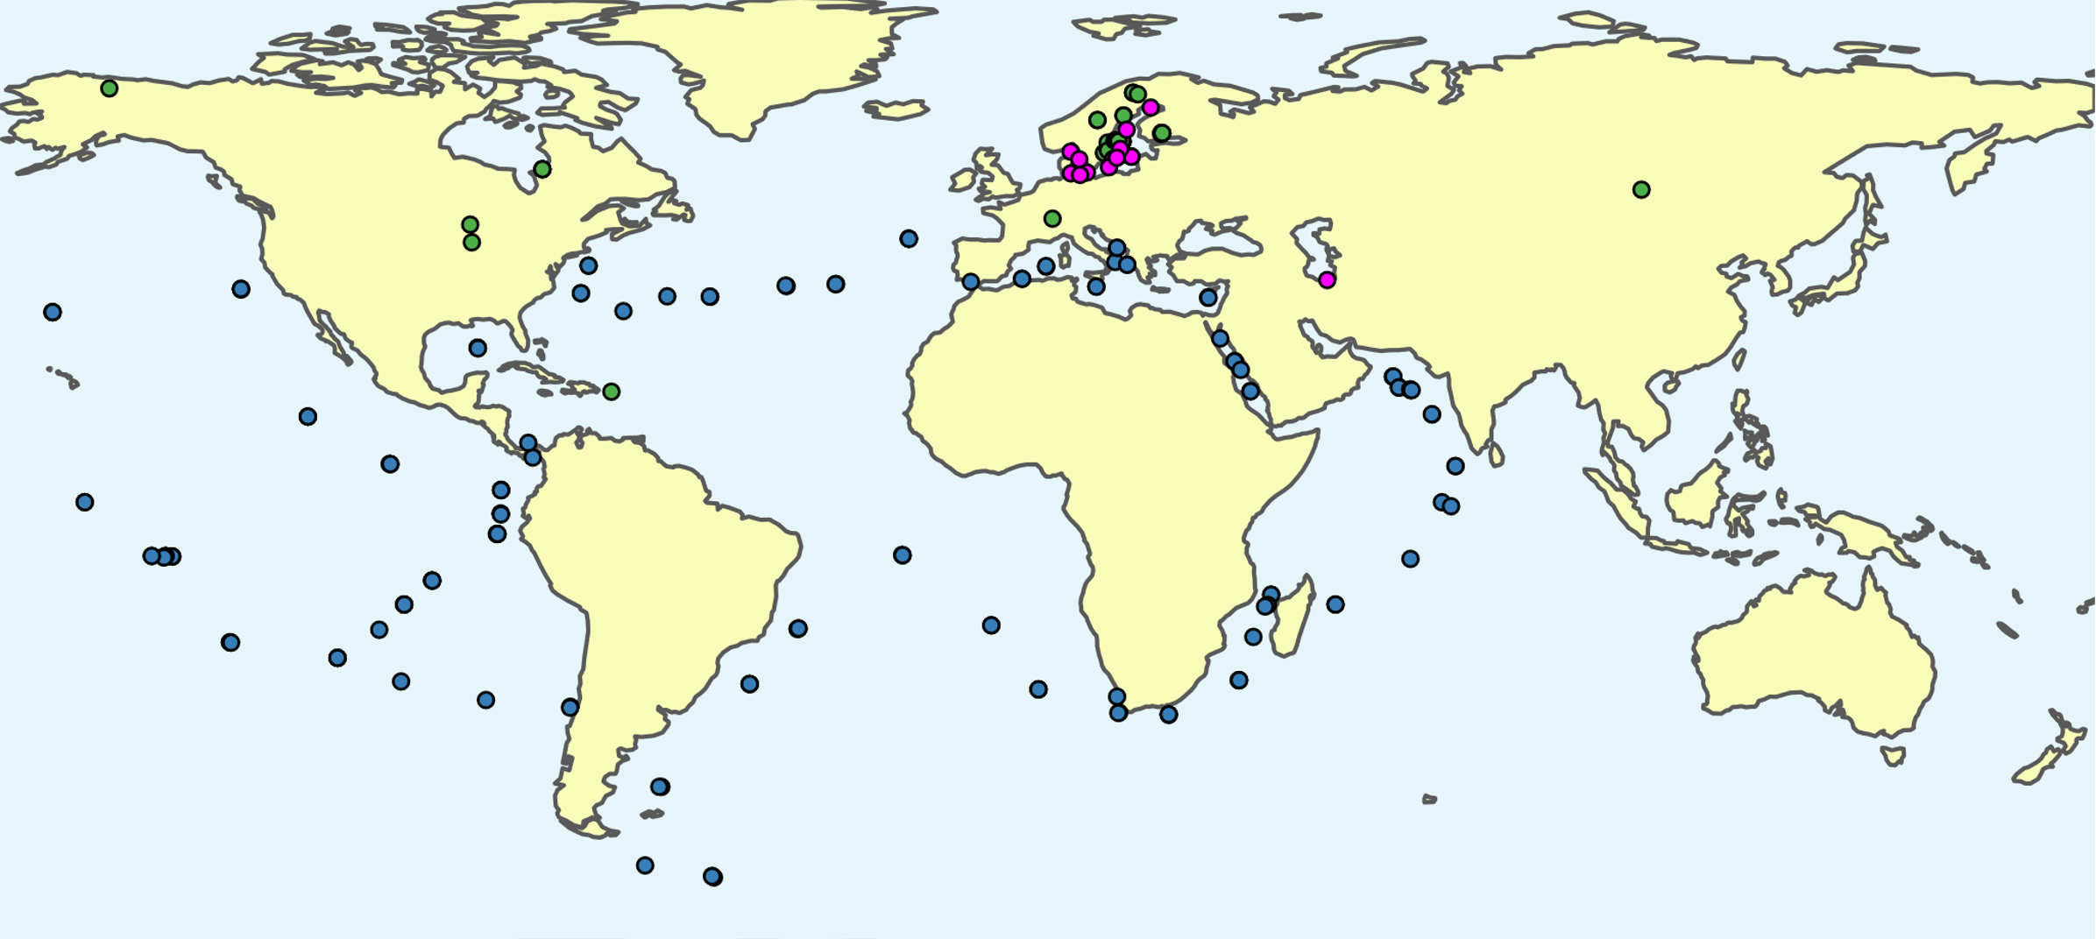
The evolution of the brackish microbiome (Planned project)
Expanded brackish dataset (include protists)
Population genomics and microdiversity
Dispersal, incl. mapping MAGs to metagenomes
Metatranscriptomics experiment
Done using POGENOM (Sjöqvist et al. ISME 2021)
Fernando

Slide 8
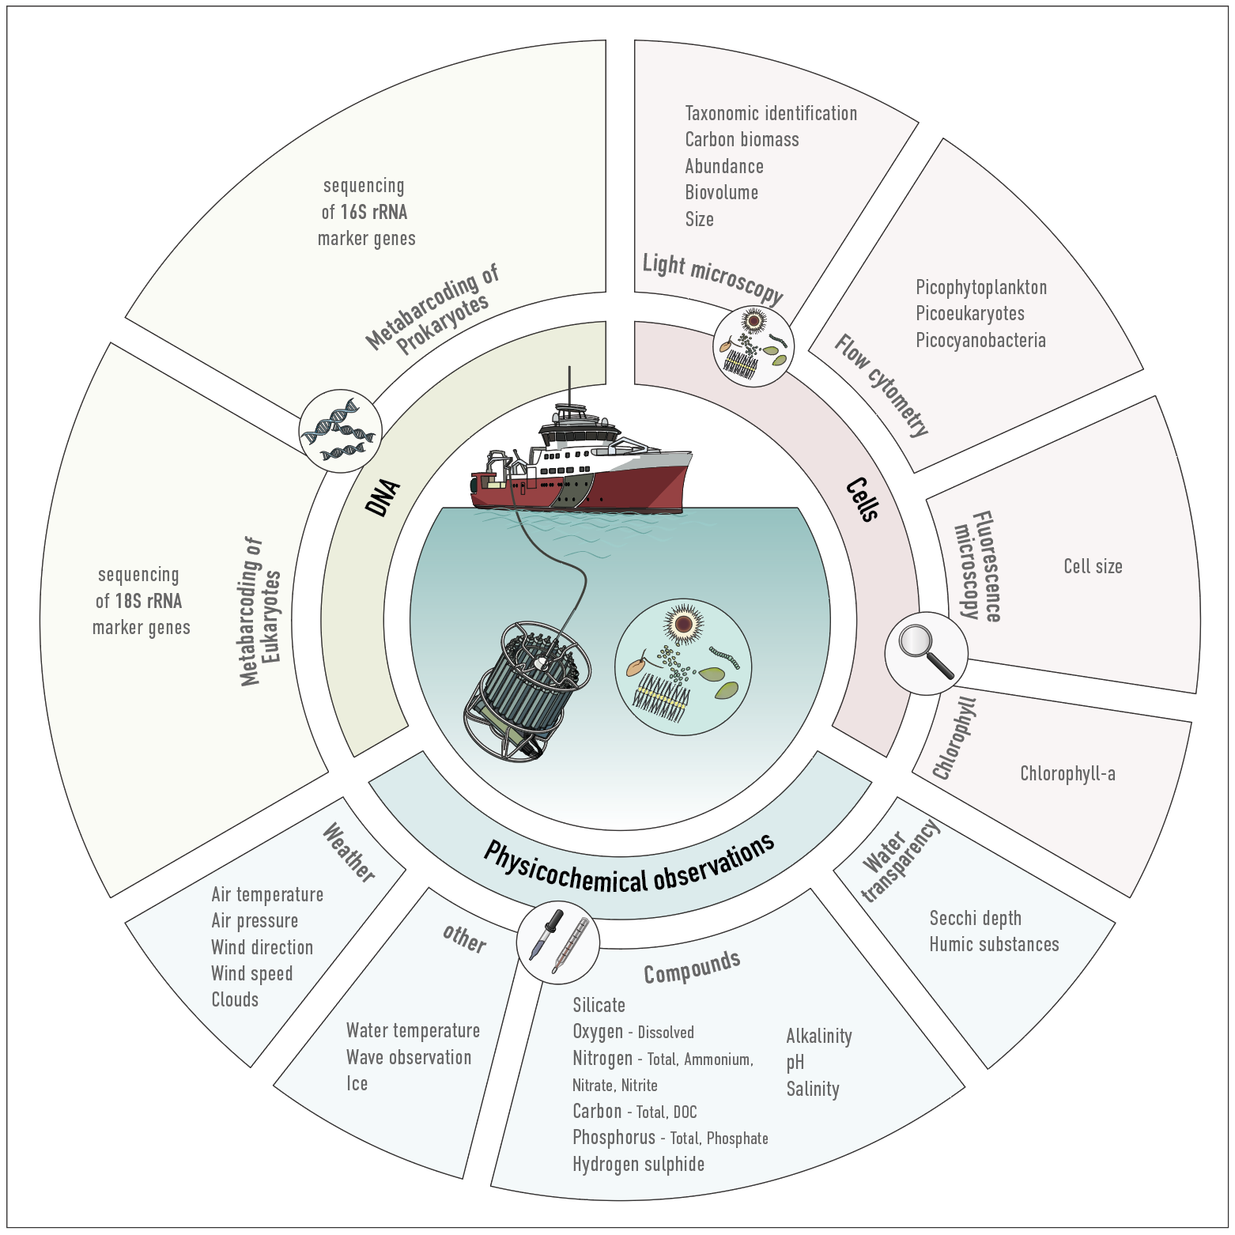
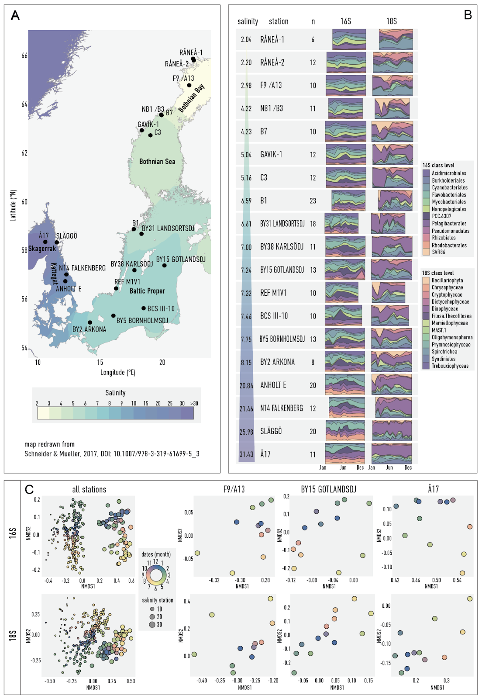
DNA metabarcoding for environmental monitoring (ongoing project)
Meike
Latz et al. 2023, in review
Latz et al. 2023, in review

Slide 9
Forecasting future microbial diversity changes from geographic and seasonal shifts
First DNA metabarcoding dataset from year-round sampling across the full length of the Baltic Sea area environmental gradients
General bacterial and protist diversity patterns tell us a lot about ecology
New data from old samples – benchmarking
Forecasting the future based on the physicochemical model
Latz et al. 2023, in review

Slide 10
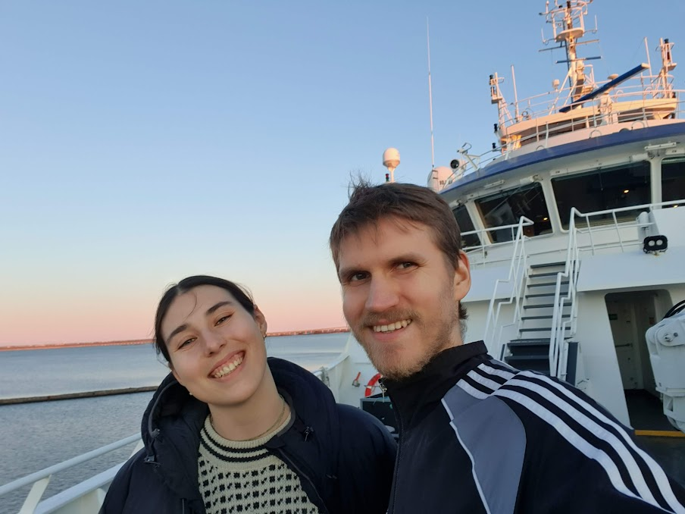
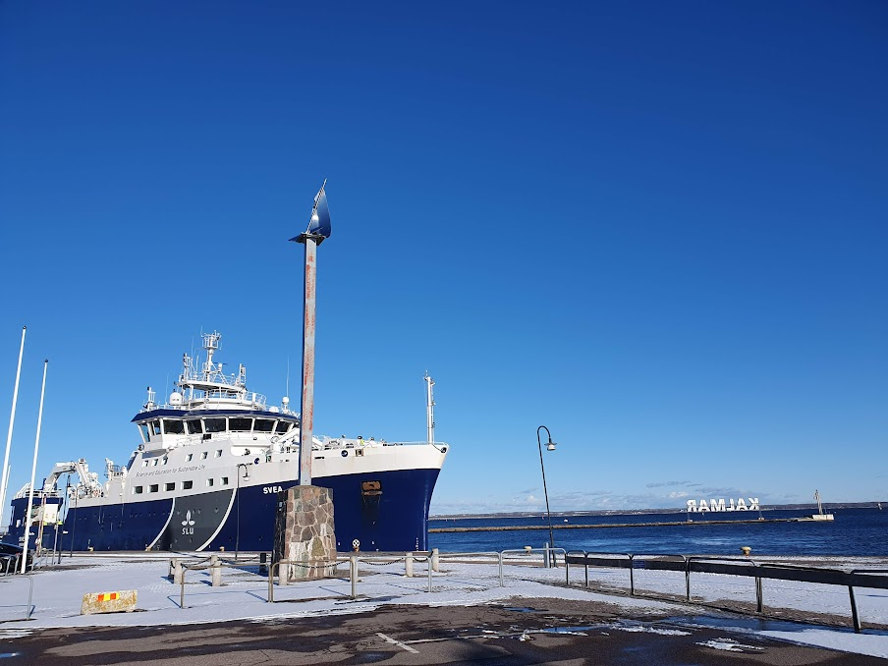
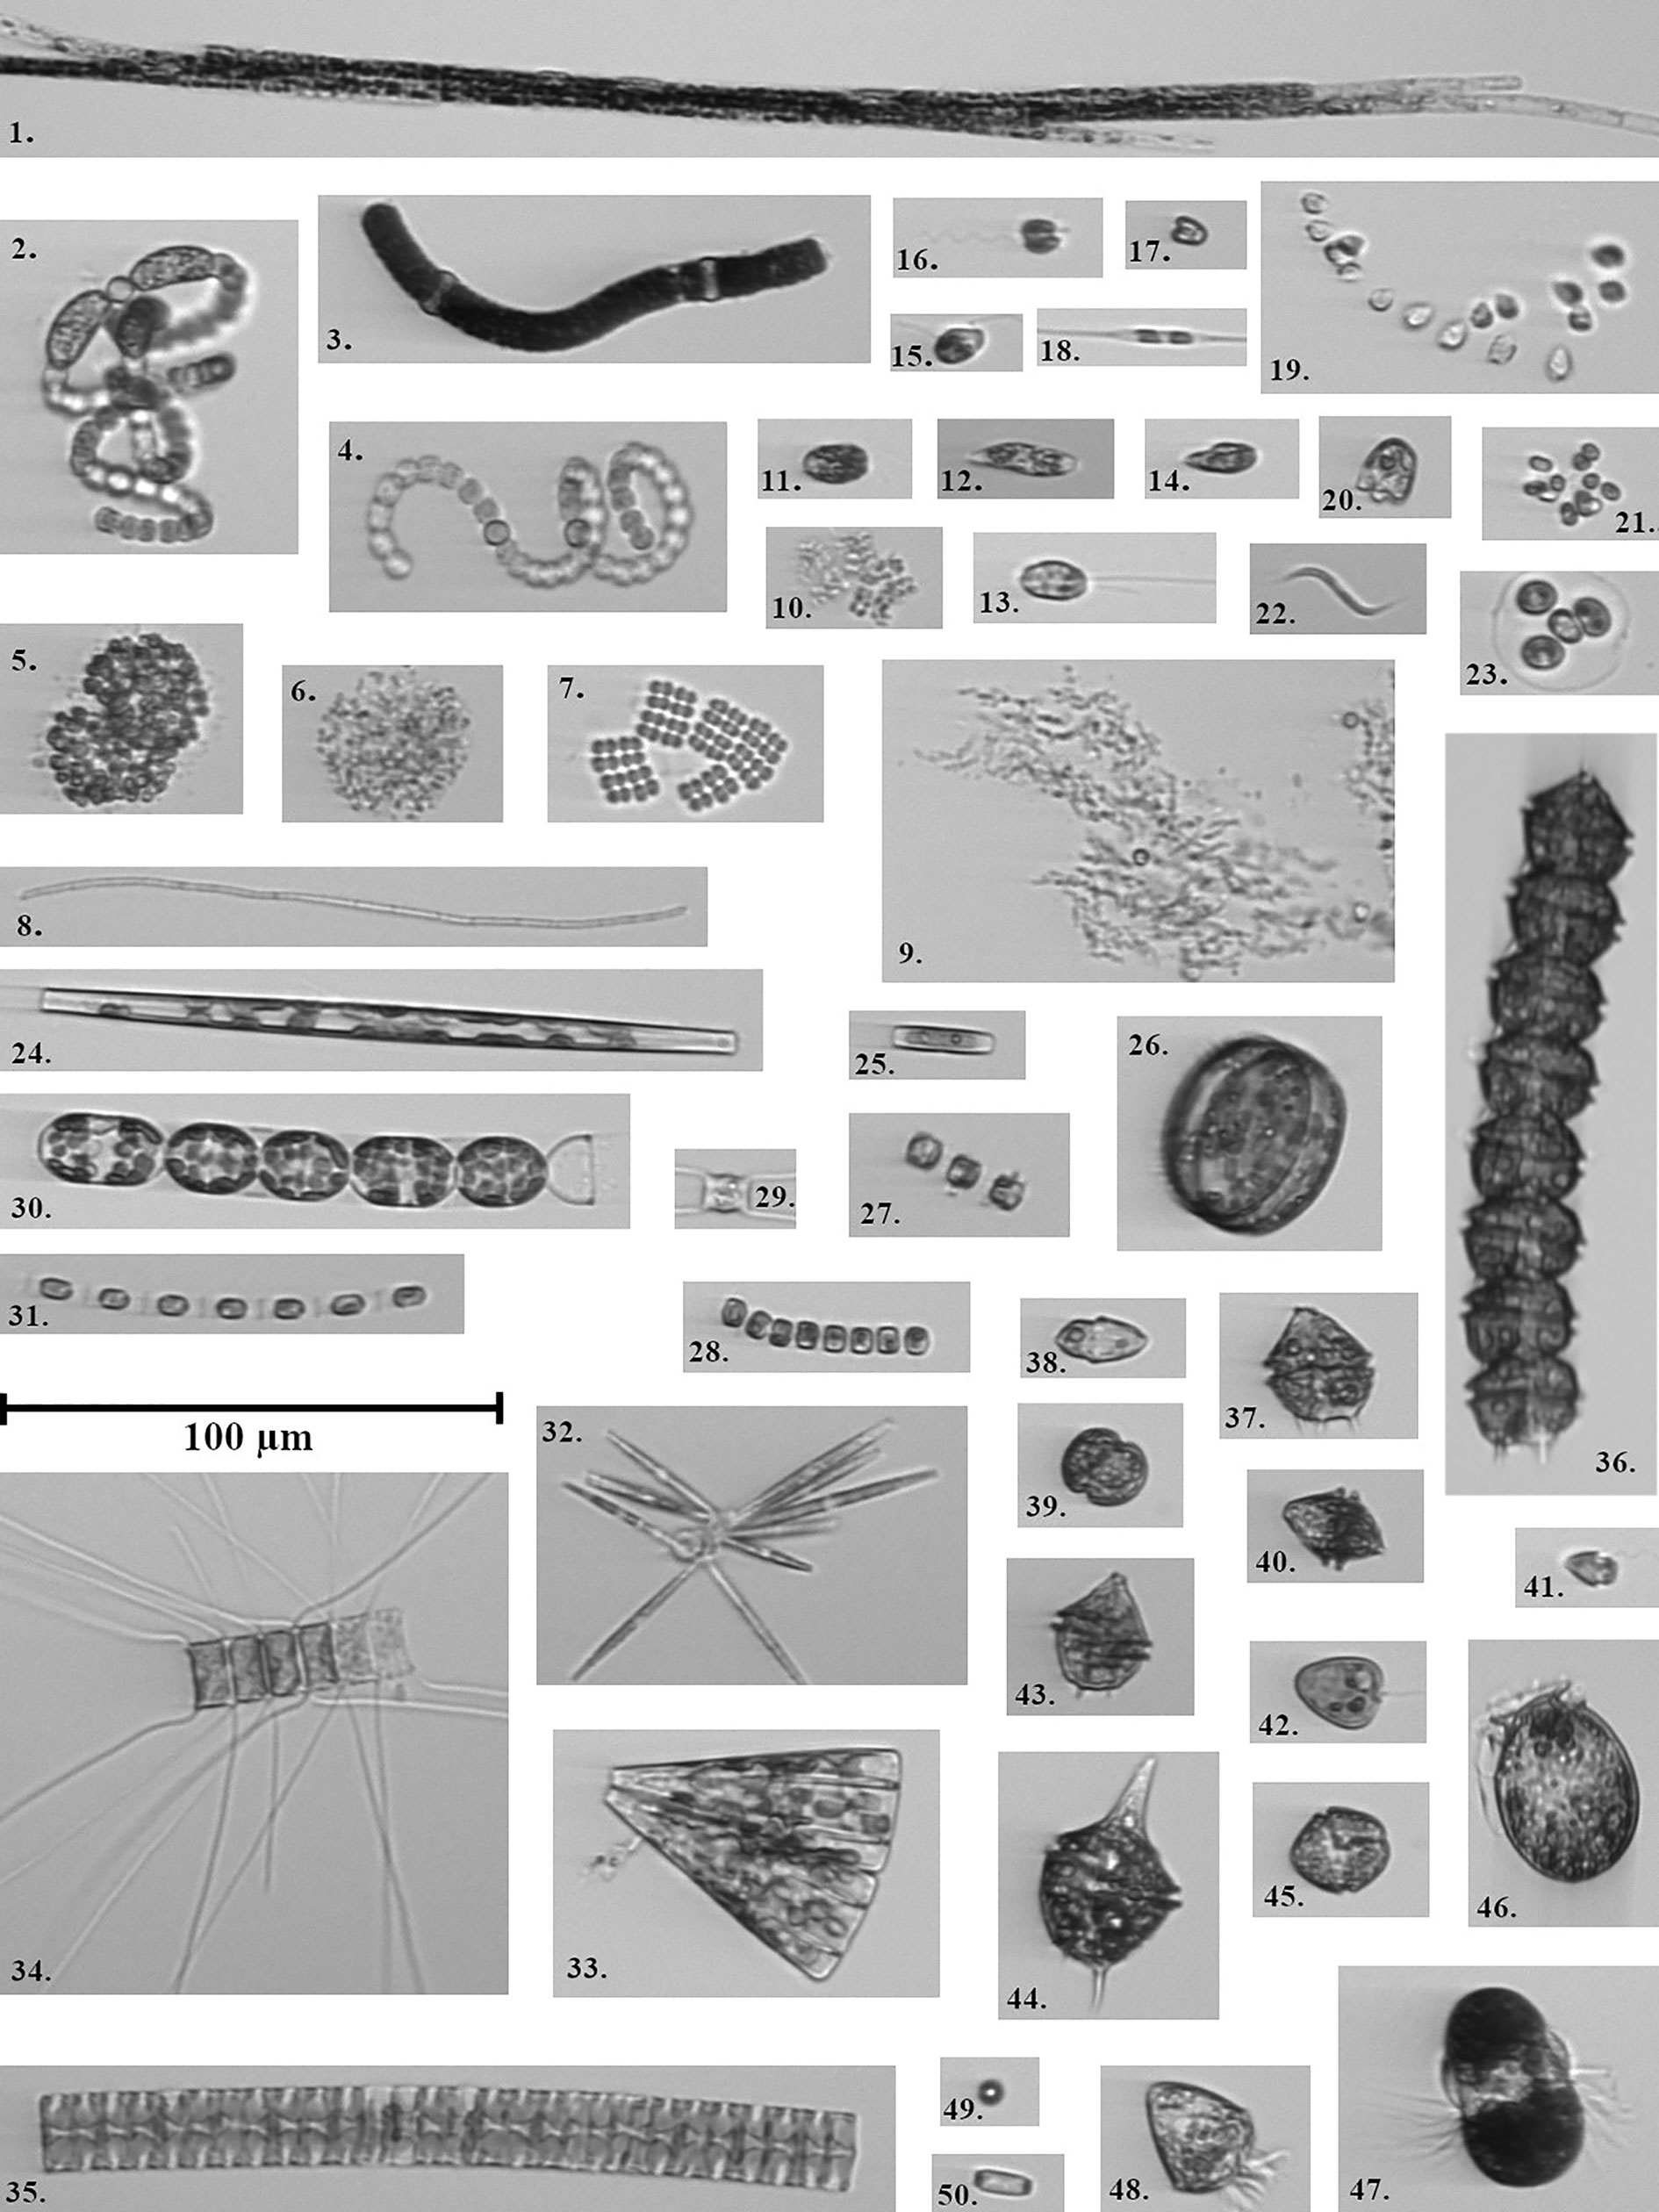
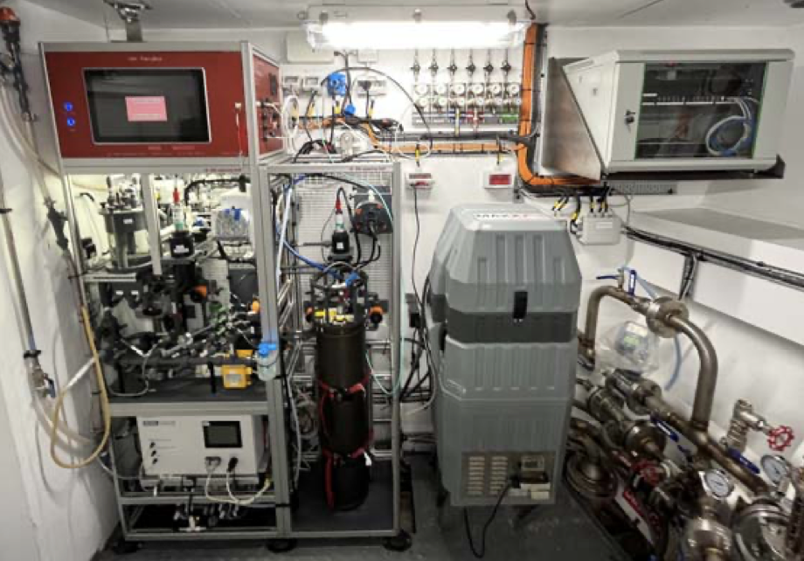
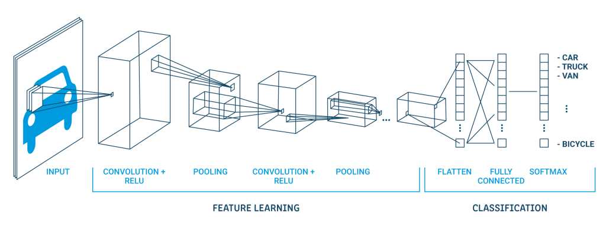
AMIME: Artificial intelligence-assisted plankton monitoring with Imaging flow cytometry and metabarcoding (side involvement)
Karin
AI plankton classification from image flow cytobot (IFCB) photos
Connected DNA metabarcoding data
Very frequent sampling (every hour)

Slide 11
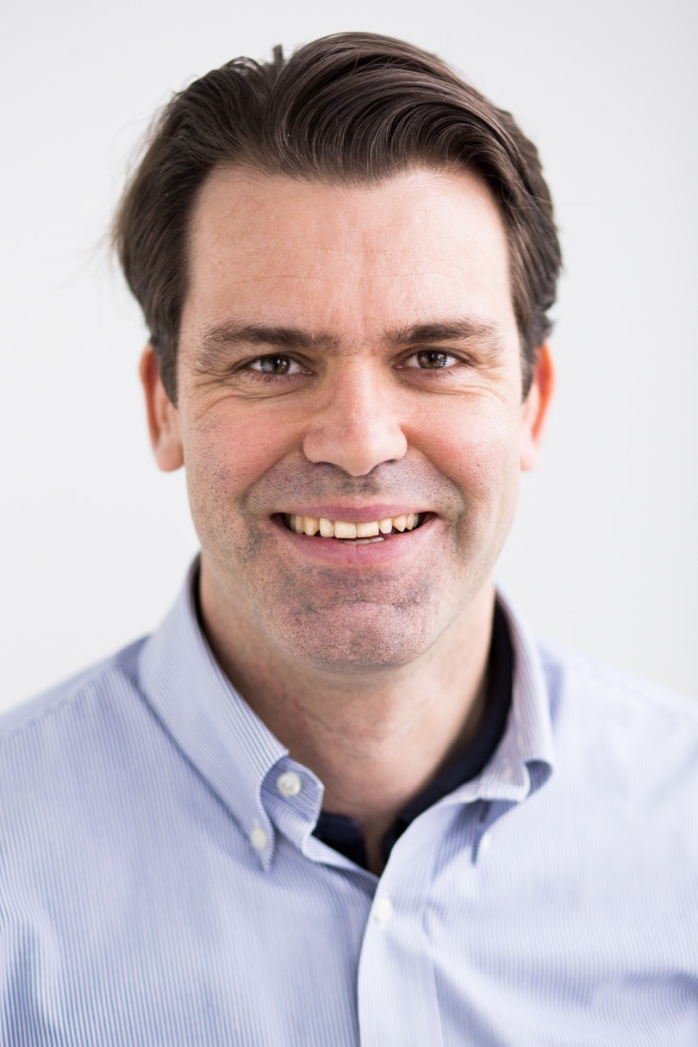
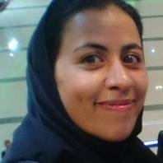



Acknowledgements
Anders Andersson
Luis Fernando Delgado
Emma Bell
Karin Garefelt
Meike Latz
Statistical Biotechnology
Lukas Käll
Maliheh Mehrshad
Stefan Bertilsson
Bengt Karlsson, Anders Torstensson et al.
Agneta Andersson, Sonia Brugel et al.

Slide 12
Opportunities and challenges of research on aquatic microbial diversity and evolution
Can we discover new biochemical wonders from the microbial world?
Yes! But we need to collaborate to bring them to the lab.
Is the microbial diversity threatened?
Possibly. But we have little clue about the extent and main threats.
Molecular methods key for monitoring!
How can we better understand the uncultivated microbial majority?
Beyond DNA – metatranscriptomics, metaproteomics, metabolomics…
New computational approaches – e.g. population genomics, AI-based methods…
Bringing the results to the lab – new cultivation methods, testing discovered genes…

